Slide 1
OPERATING SYSTEMS
Razi Uddin
Lecture # 21

Slide 2



MULTI-THREADING

Slide 3

POSIX THREADS (THE PTHREAD LIBRARY)
Pthreads refers to the POSIX standard defining an API for thread creation, scheduling, and synchronization.
This is a specification for thread behavior not an implementation.
OS designers may implement the specification in any way they wish.
Generally, libraries implementing the Pthreads specification are restricted to UNIX-based systems such as Solaris 2.

Slide 4
CREATING A THREAD
You can create a threads by using the pthread_create() call.
Here is the syntax of this call.
int pthread_create(pthread_t *threadp, const pthread_attr_t *attr, void* (*routine)(void *), arg *arg);
Here, ‘threadp’ contains thread ID (TID) of the thread created by the call,
‘attr’ is used to modify the thread attributes (stack size, stack address, detached, joinable, priority, etc.),
‘routine’ is the thread function, and
‘arg’ is any argument we want to pass to the thread function.
The argument does not have to be a simple native type; it can be a ‘struct’ of whatever we want to pass in

Slide 5
PTHREAD CREATE CALL FAILS
The pthread_create() call fails and returns the corresponding value if any of the following conditions is detected:
EAGAIN—The system-imposed limit on the total number of threads in a process has been exceeded or some system resource has been exceeded (for example, too many LWPs were created).
EINVAL—The value specified by ‘attr’ is invalid.
ENOMEM—Not enough memory was available to create the new thread.
You can do error handling by including the file <errno.h> and incorporating proper error handling code in your programs.

Slide 6
JOINING A THREAD
You can have a thread wait for another thread within the same process by using the pthread_join() call.
Here is the syntax of this call.
int pthread_join(pthread_t aThread, void **statusp);
Here, ‘aThread’ is the thread ID of the thread to wait for and
‘statusp’ gets the return value of pthread_exit() call made in the process for whom wait is being done.
A thread can only wait for a joinable thread in the same process address space
A thread cannot wait for a detached thread.
Multiple threads can join with a thread but only one returns successfully; others return with an error that no thread could be found with the given TID.

Slide 7
TERMINATING A THREAD
You can terminate a thread explicitly by either returning from the thread function or by using the pthread_exit() call.
Here is the syntax of the pthread_exit() call.
void pthread_exit(void *valuep);
Here, ‘valuep’ is a pointer to the value to be returned to the thread which is waiting for this thread to terminate (i.e., the thread which has executed pthread_join() for this thread).
A thread also terminates when the main thread in the process terminates.
When a thread terminates with the exit() system call, it terminates the whole process because the purpose of the exit() system call is to terminate a process and not a thread.

Slide 8
USER AND KERNEL THREADS
User threads—are supported above the kernel and are implemented by a thread library at the user level.
The library provides support for thread creation, scheduling, and management with no support from the kernel.
CPU not interrupted during thread switching.
Fair scheduling in case P1 has one thread and P2 has 100.
Since the kernel is unaware of user-level threads, all thread creation and scheduling are done in the user space without the need for kernel intervention, and therefore are fast to create and manage.
If the kernel is single-threaded, then any user-level thread performing a blocking system call will cause the entire process to block, even if other threads are available to run within the application.
User thread libraries include POSIX Pthreads, Solaris 2 UI-threads, and Mach C-threads.

Slide 9
USER AND KERNEL THREADS
Kernel threads—are supported directly by the operating system.
The kernel performs the scheduling, creation, and management in kernel space.
CPU switched between context switching (among threads)
Scheduling is not going to be fair in case P1 has one thread and P2 has 100.
The kernel-level threads are hence slower to create and manage, compared to user-level threads.
However, since the kernel is managing threads, if a thread performs a blocking system call, the kernel can schedule another thread in the application for execution.
Windows NT, Windows 2000, Solaris, BeOS, and Tru64 UNIX support kernel threads.

Slide 10
MULTI-THREADING MODELS
There are various models for mapping user-level threads to kernel-level threads.
Many-to-One—In this model, many user-level threads are supported per kernel thread.
Since only one kernel-level thread supports many user threads, there is no concurrency.
This means that a process blocks when a thread makes a system call.
Examples of these threads are Solaris Green threads and POSIX Pthreads.

Slide 11
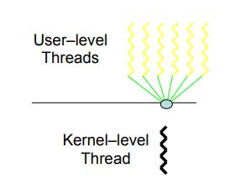
MANY-TO-ONE

Slide 12
MULTI-THREADING MODELS
One-to-One—In this model, there is a kernel thread for every user thread.
Thus, this model provides true concurrency.
This means that a process does not block when a thread makes a system call.
The main disadvantage of this model is the overhead of creating a kernel thread per user thread.
Examples of these threads are WindowsNT, Windows 2000, and OS/2.

Slide 13
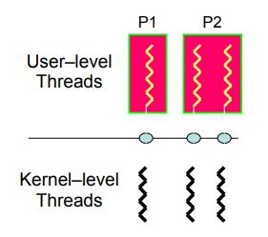
ONE-TO-ONE

Slide 14
MULTI-THREADING MODELS
Many-to-Many—In this model, multiple user-level threads are multiplexed over a smaller or equal number of kernel threads.
Thus, true concurrency is not achieved through this model.
Examples of these threads are Solais 2 and HP-UX.

Slide 15
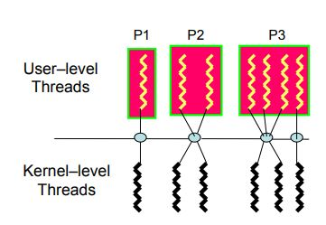
MANY-TO-MANY

